Slide 1
JWST Master Class- Overview and Training Package
Themiya Nanayakkara
JWST MASTER CLASS MELBOURNE 2022

Slide 2
Objectives of this workshop
Get yourself familiar with JWST observing modes and Proposal Tools.
Our aim is to get you to a point where you’ll feel comfortable using the proposal tools and discussing with your colleagues.
We have three different types of sessions:
Generic talks: Mission Status, Observing modes, Proposal and ancillary tools.
In depth proposal tools hands-on sessions: ETC and APT (slides and assignments to work on).
Observing mode hands on sessions:
Short presentation with general strategy advice.
Assignment to complete.

Slide 3
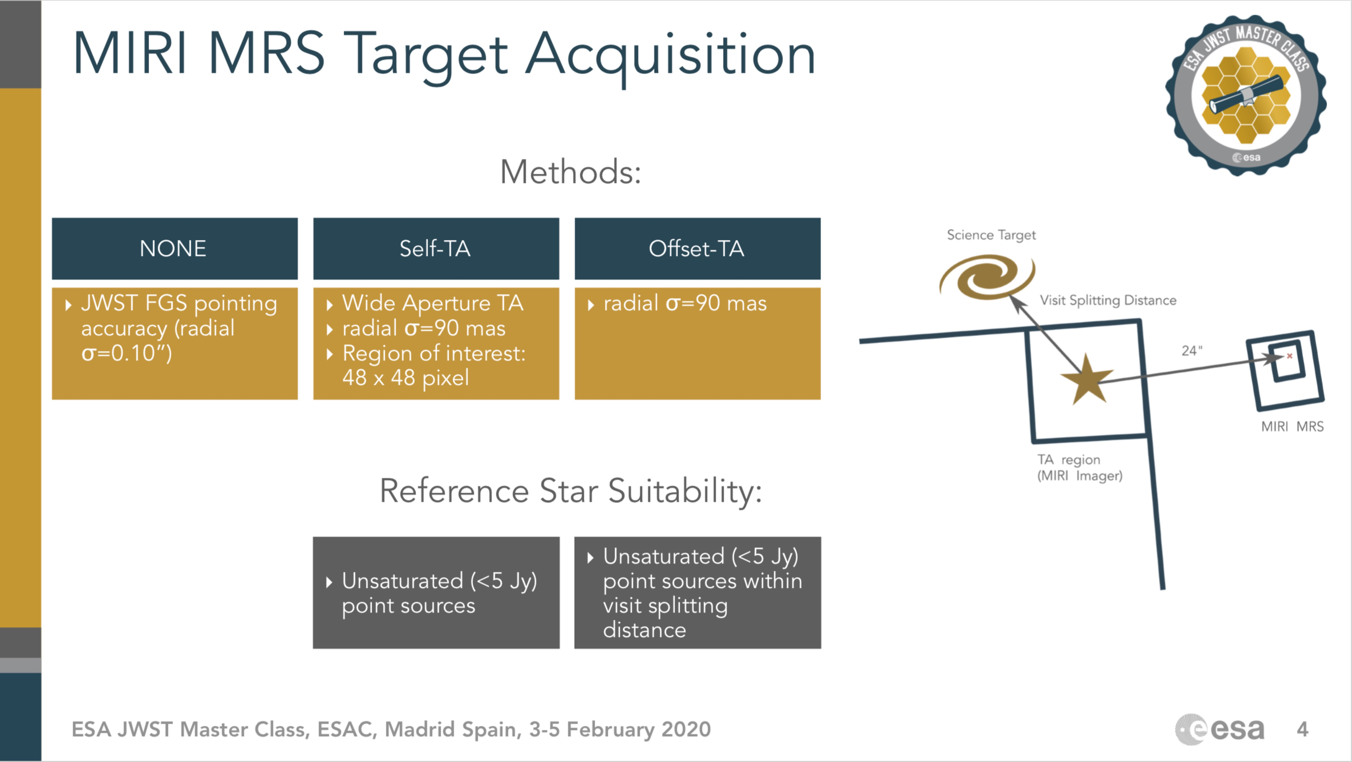
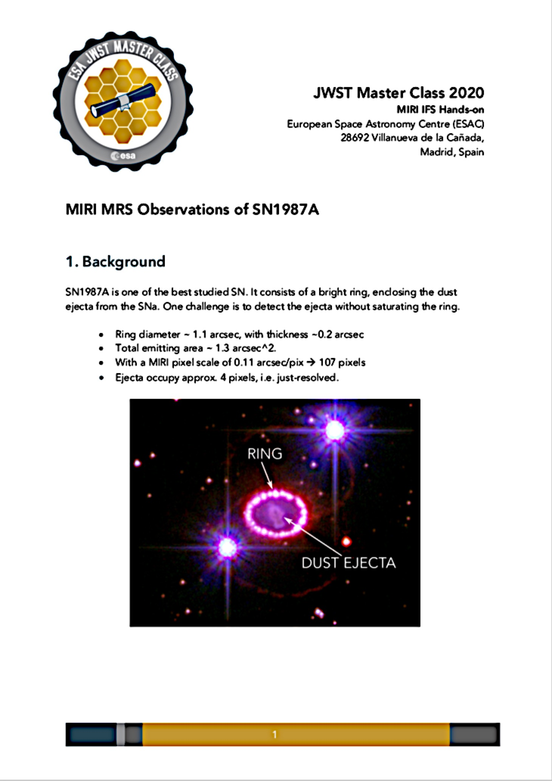
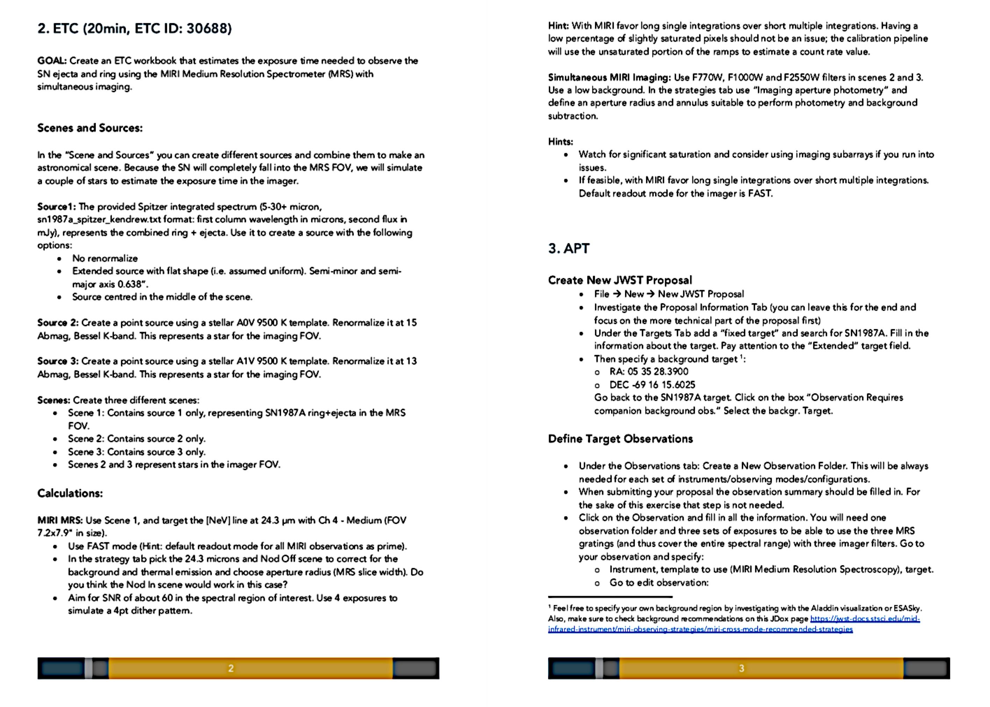
What to expect from the hands-on sessions
Short presentations that focus on strategies and general recommendations
An assignment to work on
During the hands on sessions we will work in groups.

Slide 4
What to expect from the hands-on sessions
The assignments are in general a step by step description of how to put together an observing proposal.
They are not meant to go into the details of every “corner case” but rather to cover the more standard way of using of each mode and tool (ETC, APT).
You might have different/better ideas on how to complete the exercise, for instance, the Exposure Time Calculator part of it. Go for it!
There is a large support team through the online helpdesk for anything we cannot answer and do further discussions on day 3.
If you find a roadblock in some part ask for our help/work with your neighbors to solve it.

Slide 5
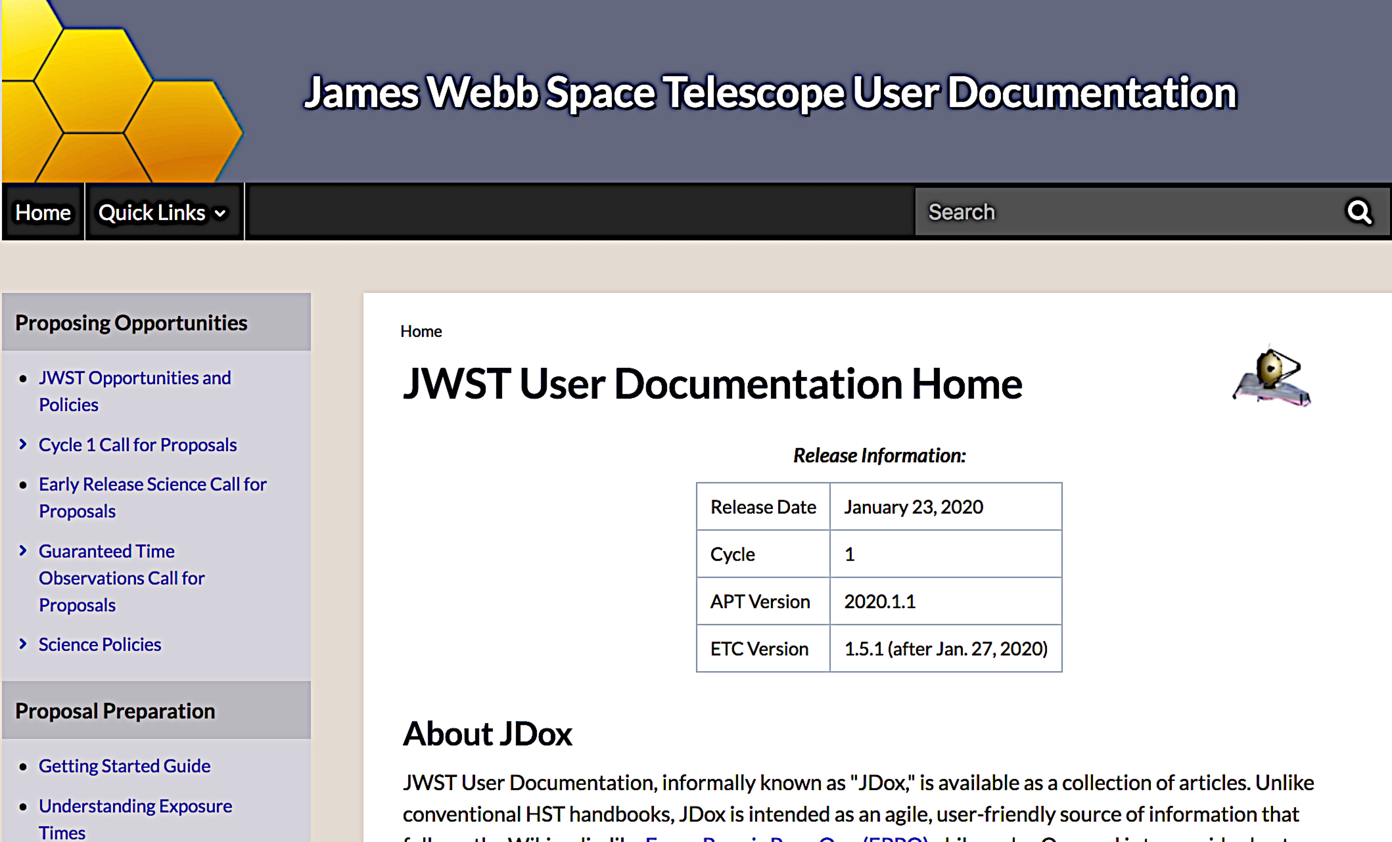
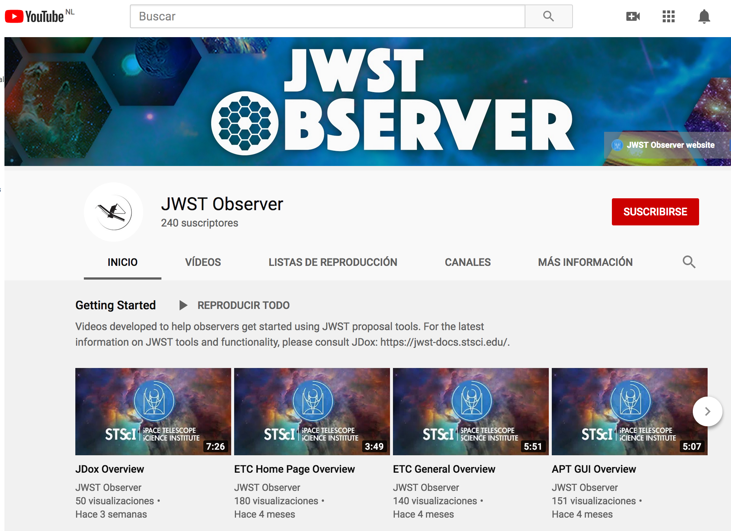
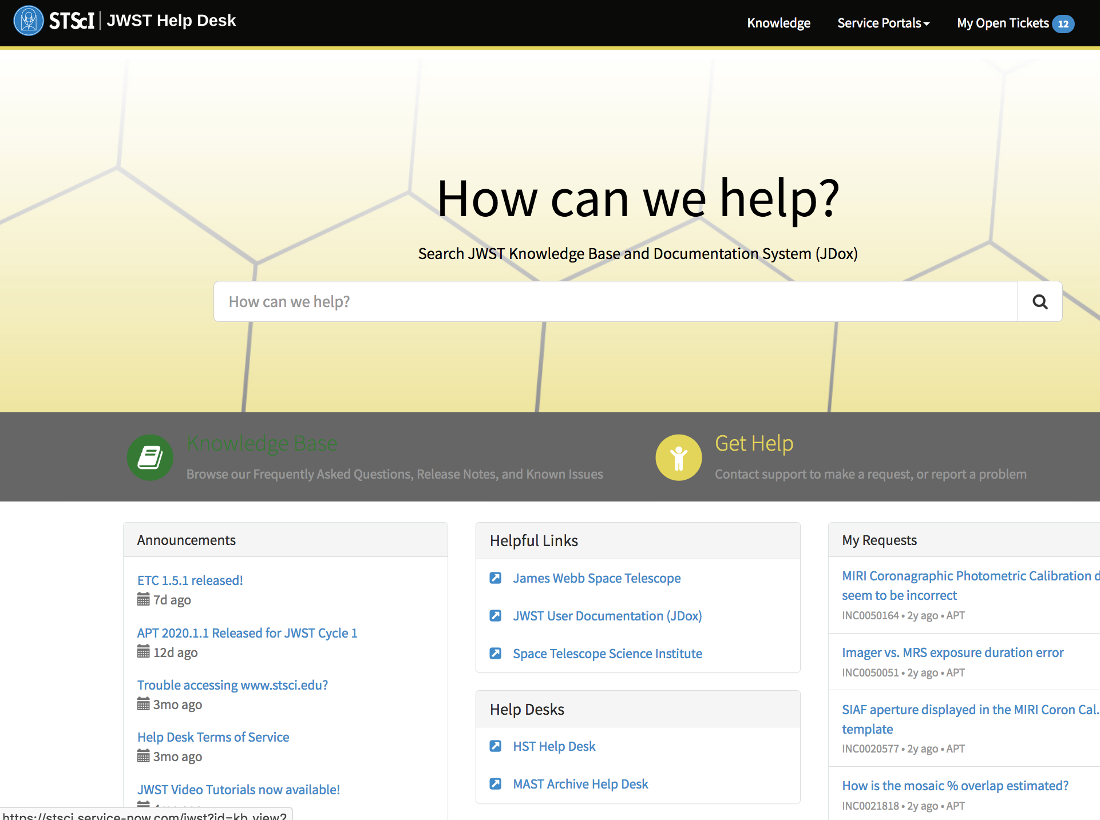
What to expect from the hands-on sessions
If you can’t finish the ETC part half way through the session move to the APT part. You’ll be able to look at the proposed ETC solution later.
Feel free to ask questions anytime.
No one knows everything! There are many resources you can use to find help and information.
Helpdesk
Youtube
tutorials
JDox

Slide 6
Getting ready for your local workshop
The Master Class program has been designed so you can closely replicate it in your workshop.
Before the workshop encourage participants to do the pre-workshop assignments.
We have marked some sessions as “must-haves”:
Mission Status
Cycle 1 Call for Proposals
Available Proposal Tools
Available observing science modes
Proposals preparation roadmap
ETC Hands-on
APT Hands-on
Other hands-on as needed depending on the interests of your community.
How to write a successful proposal.

Slide 7
Getting ready for your local workshop
During this week think about how to reduce the program/adapt the sessions for your own workshop.
Consider duration, number of attendees, level of expertise.
Talk to your Point of Contact.
Take the opportunity to do some networking and share ideas with other participants.
If you don’t have it yet, ideally you should have an agenda before finishing the Master Class.

Slide 8
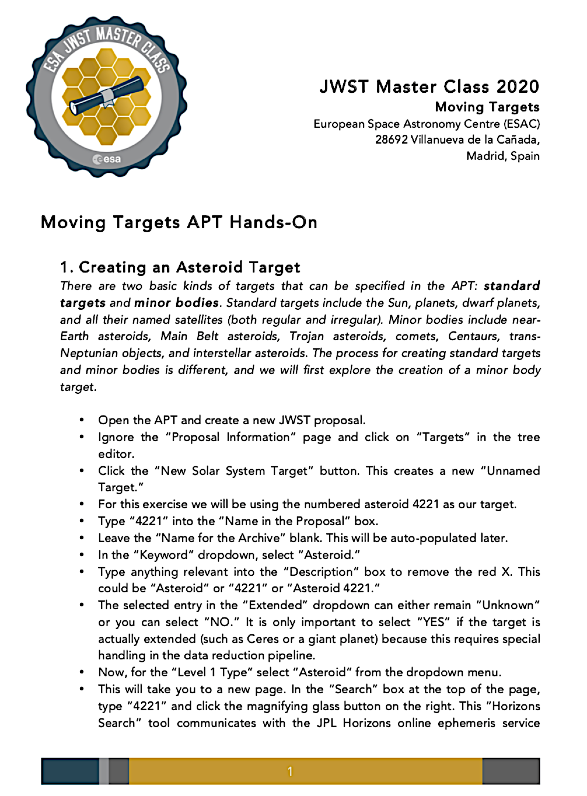
Getting ready for your local workshop: We are here to help
At least one ESA person will travel to each european workshop to provide direct support.
For those we can’t travel to, let’s talk about all details this week.
A “Training Package” with all materials from the Master Class will be available this week via ESABox.
Use and adapt the materials as needed. The package will include slides, exercises and all associated files you will need to completer each of them.
We will also share the ETC workbooks with you (read-mode only)

Slide 9
Getting ready for your local workshop: We are here to help
At least one ESA person will travel to each european workshop to provide direct support.
For those we can’t travel to, let’s talk about all details this week.
A “Training Package” with all materials from the Master Class will be available this week via ESABox.
Use and adapt the materials as needed. The package will include slides, exercises and all associated files you will need to completer each of them.
We will also share the ETC workbooks with you (read-mode only)
Enjoy!!

